Slide 1
Maths Daily Practice
Grade 1 - Week 1
Complete this work in a notebook at home. This is not mandatory homework.
Therefore, it does not need bringing into school. This is optional practice to support the learning taking place in school.

Slide 2
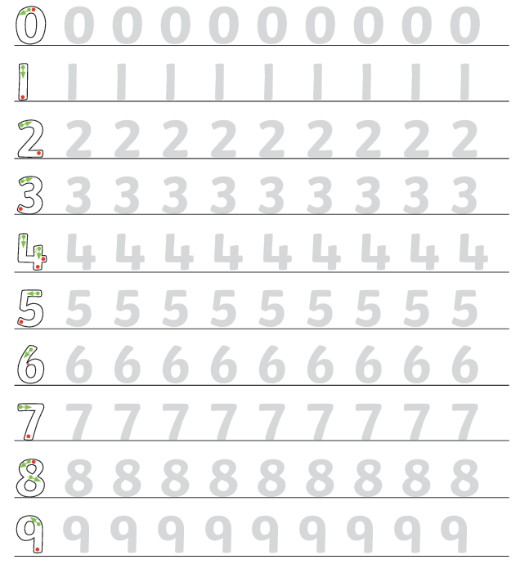
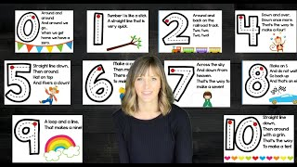
Daily practice 1
Correct number formation
All nine digits have a correct way of being written. These should be practiced regularly to ensure fluent writing.

Slide 3
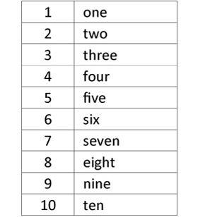
Daily practice 2
Number spelling
Many numbers do not follow simple phonetic rules. Therefore, students must practice and remember how to spell numbers to 10.
Practice writing these numbers and then test your child to see if they can remember their spellings without looking.

Slide 4
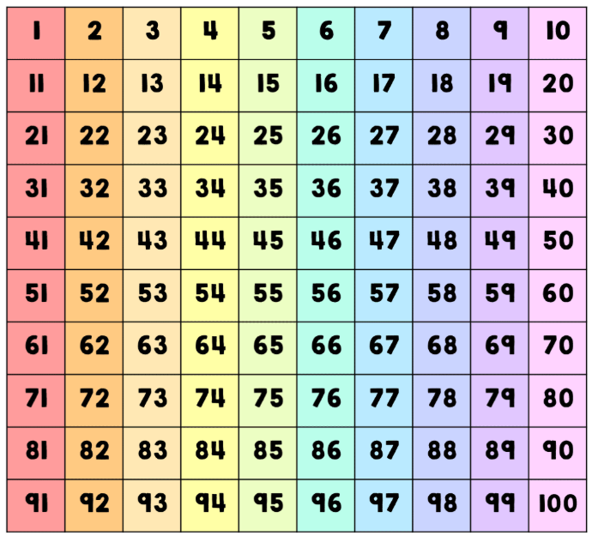
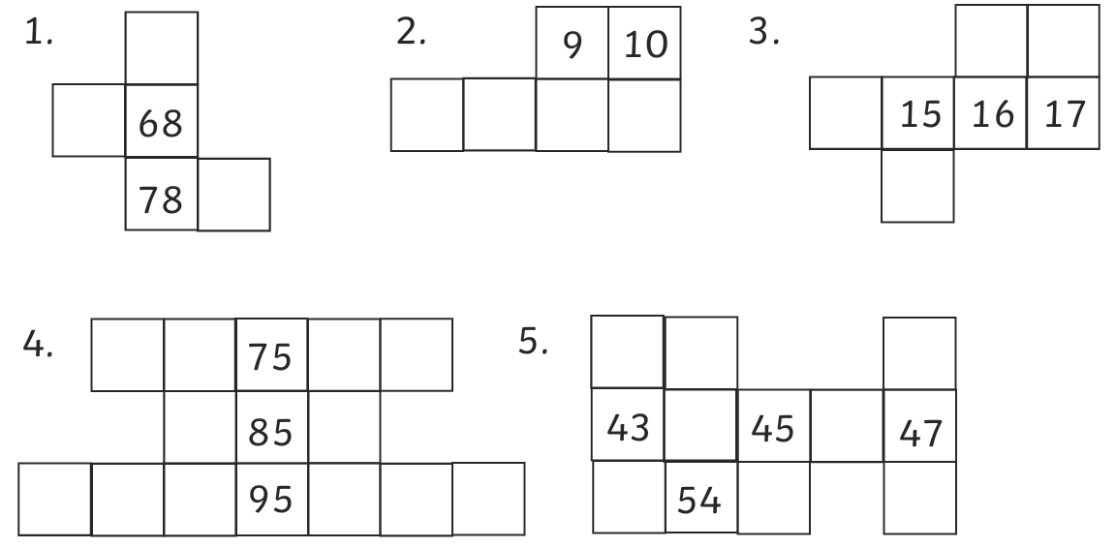
Daily practice 3
Place Value
Use a 100s grid and place value understanding to find the missing numbers.

Slide 5
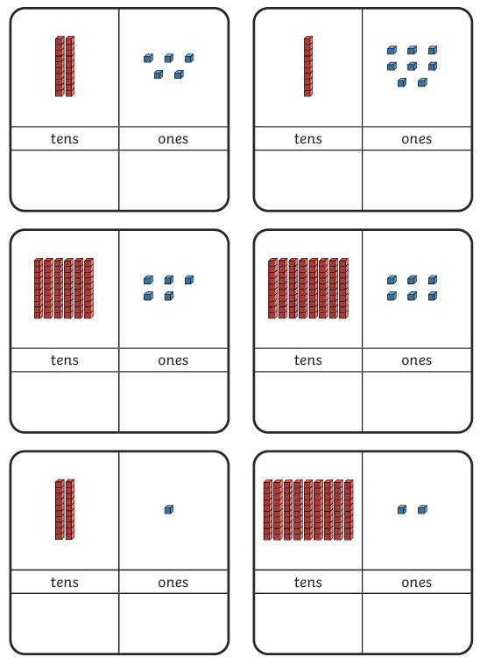
Daily practice 4
Tens and Ones
Count the tens and ones, then add them together to make a 2-digit number.

Slide 6
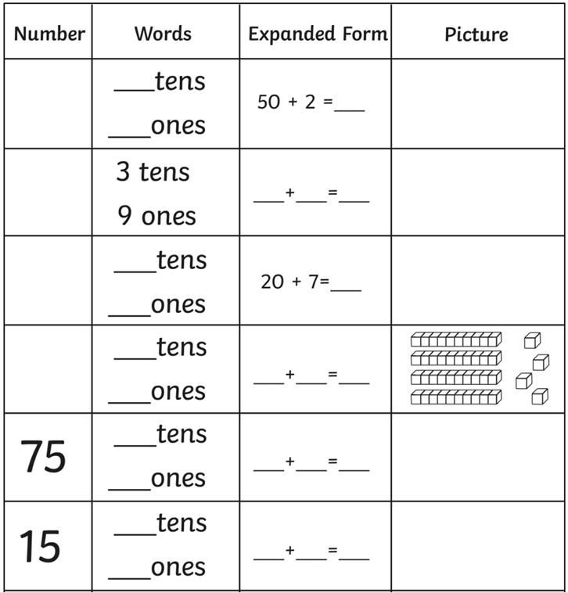
Daily practice 5
Tens and Ones
Use the information to
Find the whole number
Find how many tens and ones
Write the addition sum (expanded form)
Draw a picture to represent that number.

